Slide 1
Ads Insights
Chirag Mangla
ichirag0610@gmail.com

Slide 2
Agenda
01. Qty Overview
02. Competitive Analysis
Analyzing Quarterly Revenue and Ads by Different Brands.
Differentiating Brands On the basis of Various factors and Business Model.
03. Media Plan
04. Annual Review
Media plan to run Digital Ad Campaign and Compliment Tv Ads
Overall review of Company Financials and Growth.

Slide 3
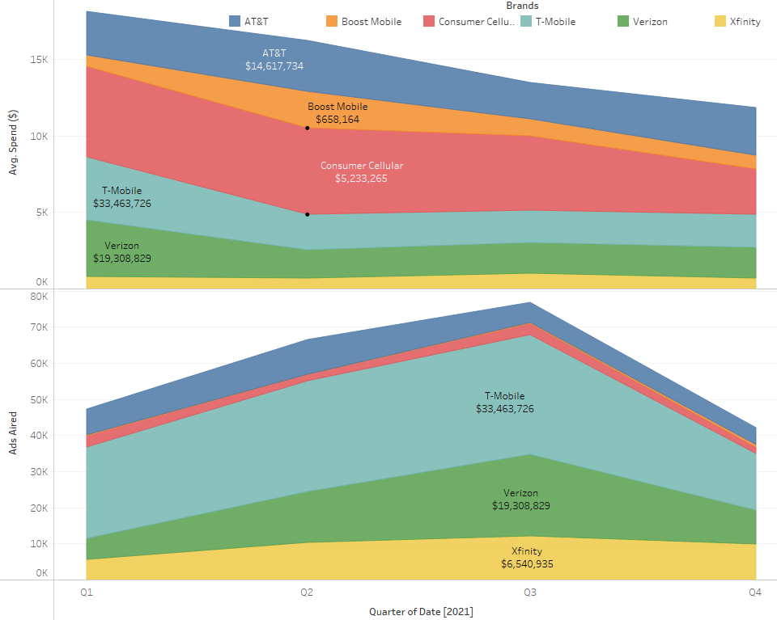
Quarterly Overview
Q3 had the greatest number of Ads aired whereas, Q1 generated most Revenue.
Consumer Cellular spent highest on average on an Ad. Nearly 67% more than AT&T.
Q4 had least no of Ads as well as Revenue.

Slide 4
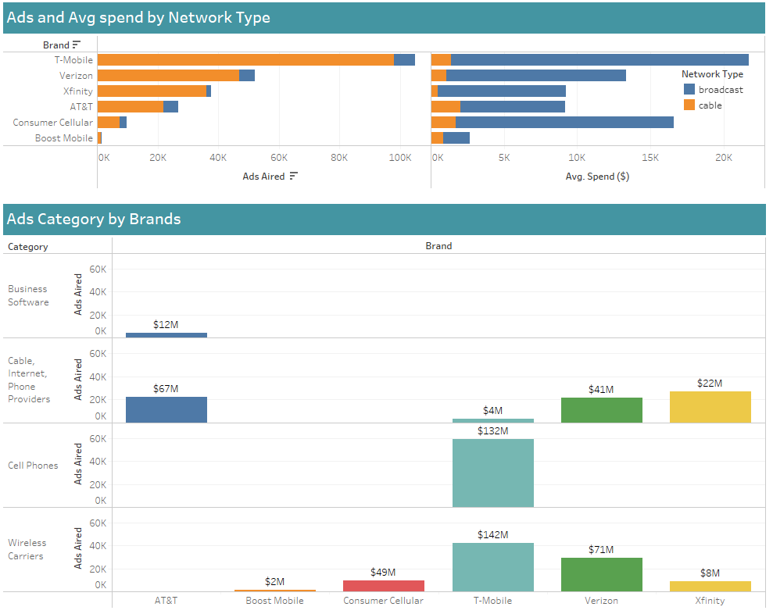
Competitive Analysis
Verizon & Xfinity are direct Competitors with both of them running ads for Cable, Internet, Phone Providers and Wireless Carriers Category.
Xfinity has Largest 96% of its ads on Cable and 14% ads run Early Morning.
Verizon airs 15% of their ads on Weekends.
Boost Mobile & Consumer Cellular are direct Competitors and airs ads only for Wireless Carriers Category.
Though they both run very limited ads, Average Spend for Consumer Cellular is highest among all with $5000 per Ad. It also airs highest percentage of Broadcast Ads with 25%.

Slide 5
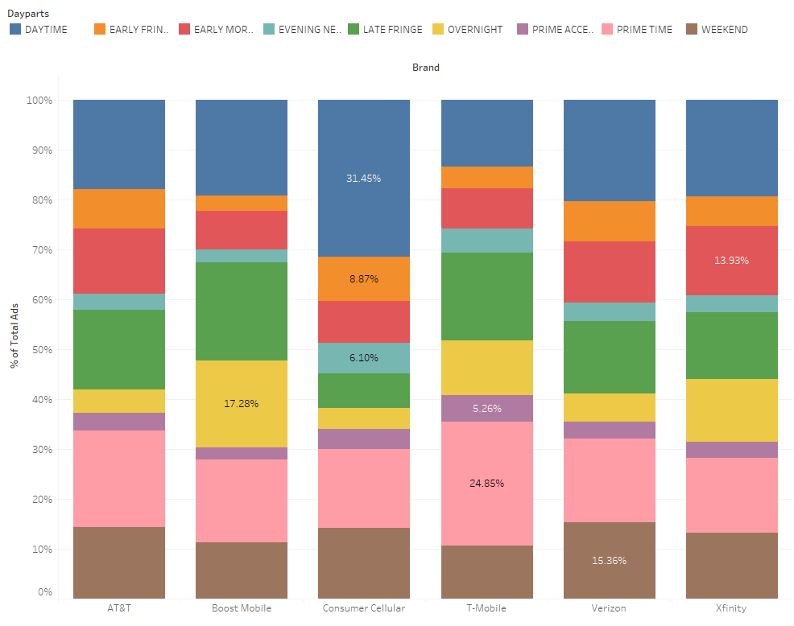
Competitive Analysis
T-Mobile runs highest No. of Ads 100K among 2 major Categories – Cell Phones and Wireless Carriers. Most of its Ads (25%) are aired during Prime Time.
It also generates the most Revenue among all the brands with $280M.
AT&T is the only brands that airs Ads for Business Software Category.
On an Average Broadcast Ads are 10x Expensive than Cable Ads.

Slide 6
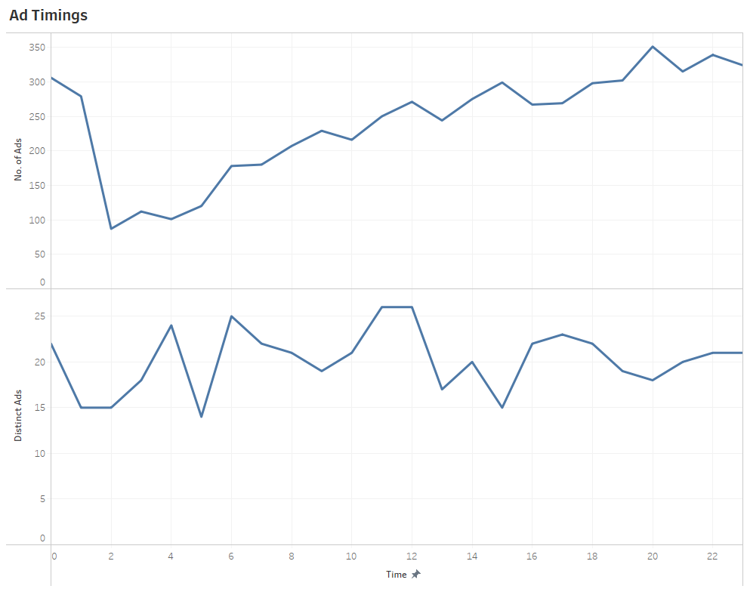
Media Plan
Most Distinct Ads were run at 11 A.M. - 01 P.M. in the afternoon.
Ads start Increasing from 5 A.M. And peak at 8 P.M.
Most recurring Ads are aired at 3 P.M.

Slide 7
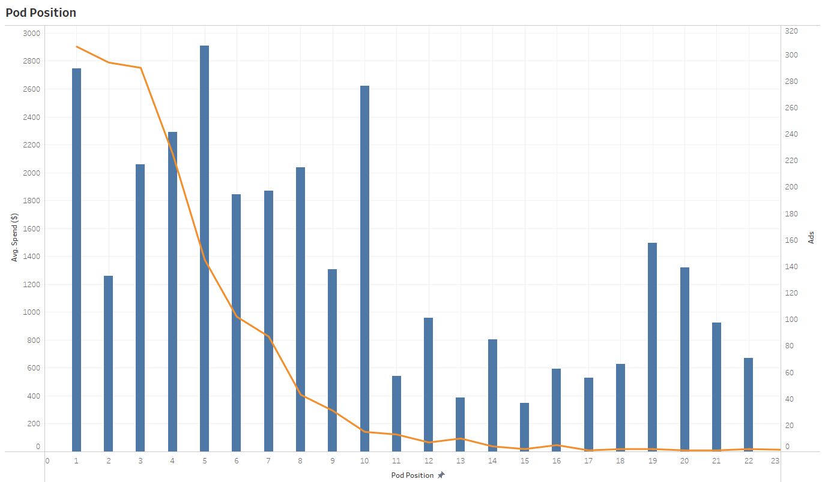
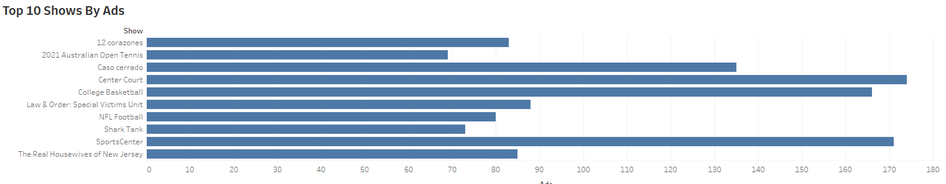
Media Plan
2nd Pod position is most Value for Money as it offers high exposure at lower cost.
Most Ads are aired in a Sports break

Slide 8
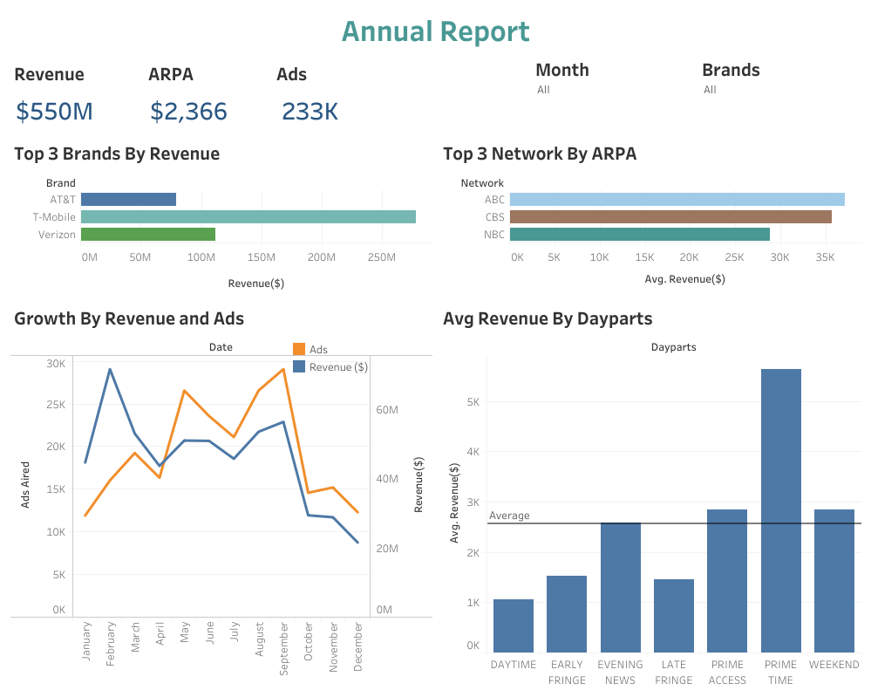
Annual Review
Report Link
*ARPA- Average Revenue Per Ad

Slide 9

Thank you
Chirag Mangla

